Slide 1
Plasma Diagnostic Techniques: Laser Induced Fluorescence (LIF/TALIF) spectroscopy
York Plasma Institute

Slide 2
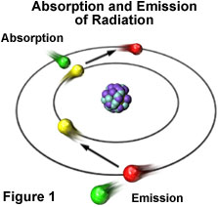
Optical diagnostics
Emission spectroscopy
passive
simple
robust
indirect
model based
data needed
Laser spectroscopy
direct
highly reliable
active
involving
expensive
Combination of passive and active methods

Slide 3
Detection of Atomic & Molecular Radicals by Laser Induced Fluorescence
Local measurement with high temporal resolution (ns) and very high detection sensitivity (provided background radiation is low).

Slide 4
Diagnostic overview
to probe atomic oxygen
VUV absorption
Absolute density
Synchrotron ➔ big facilities
Vacuum environment ➔ non realistic environment
Niemi et al. – 2013 – APL 103 034102
Nanosecond TALIF
Spatially resolved measurements
Gas composition assumed ➔ non realistic environment
Calibration required ➔ no direct absolute density
Niemi et al. – 2005 – PSST 14 375
Picosecond TALIF
Spatially resolved measurements
No assumption on gas composition
Calibration required ➔ no direct absolute density
4

Slide 5
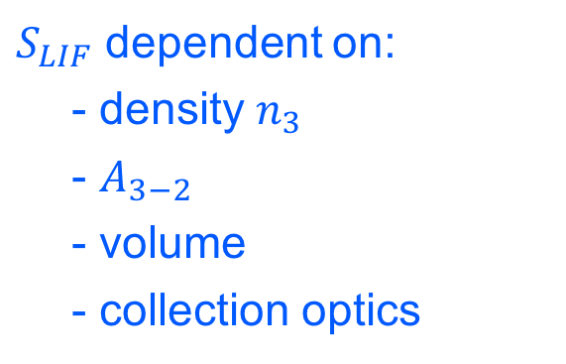
Laser Induced Fluorescence
$S_{LIF}$ dependent on:
- density $n_{3}$
- $A_{3−2}$
- volume
- collection optics

Slide 6
TALIF: principle
Two-photon Absorption Laser-Induced Fluorescence (TALIF)
➔ Ground state density deduced by measuring the fluorescence signal and lifetime of the excited state
Excited state
laser excitation 2 x hν
hν
De-excited state
Ground state

Slide 7
Quenching
Collisional quenching of laser excited state
TALIF
Natural lifetime
Natural lifetime
Quench partner density
hν
Quench partner density
hν
Collisional quenching
Effective decay rate
Effective lifetime
Effective decay rate
Effective lifetime
hν
Quenching coefficient
Quenching coefficient
Collision
(remember lecture 3)

Slide 8
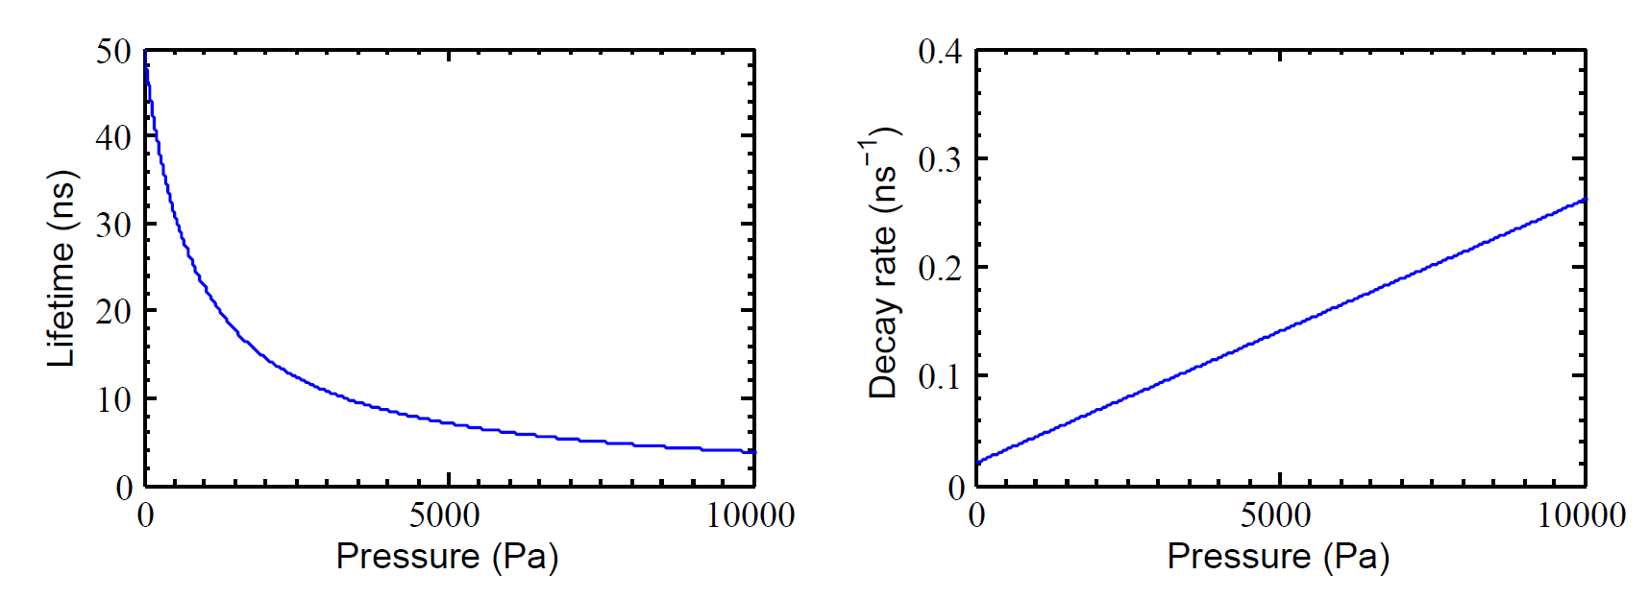
TALIF: Why picosecond?
Example values:
Natural lifetime:
Quenching coefficient:
8

Slide 9
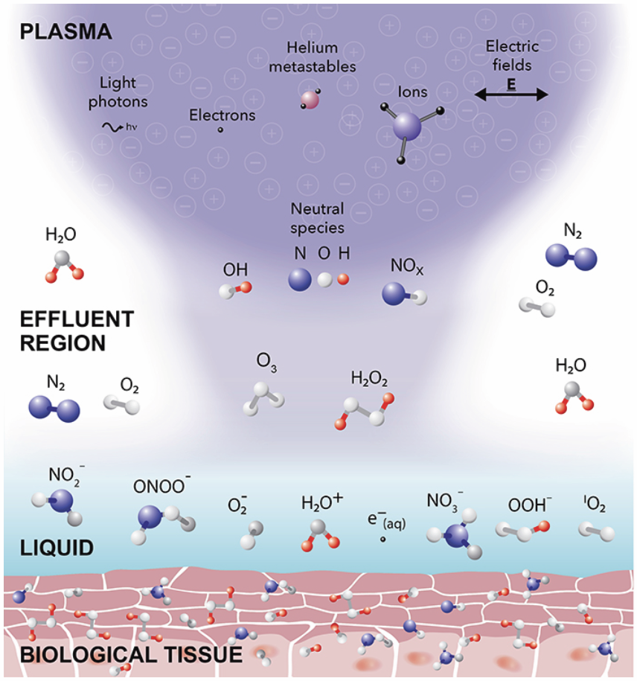
Example: Technological applications incl. biomedical
Atmospheric pressure low-temperature plasmas
Atoms: Precursors
Determination of N, O & H densities

Slide 10
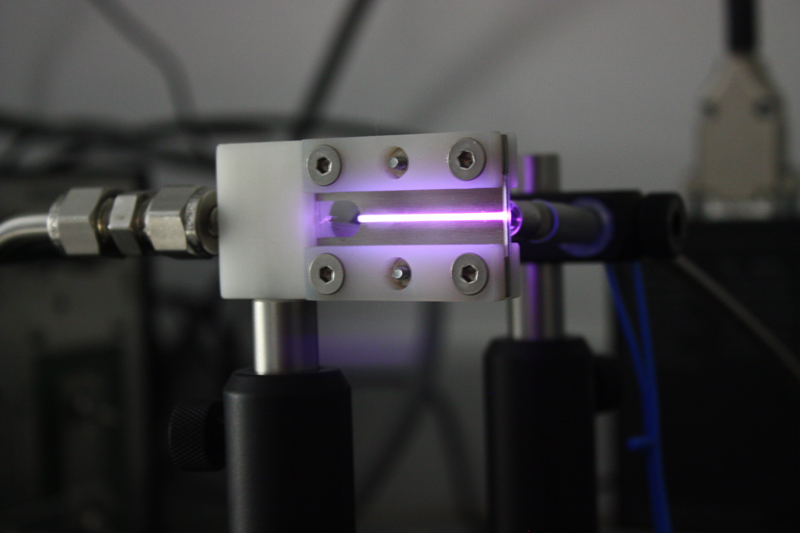

RF μAPPJ
Parameters | Typical values
Excitation | 13.56 MHz
Power discharge | 1-2 W
Feed gas | 1 slm He + 0-1 % O2 – N2/O2
Channel size | 1 x 1 x 30 mm³
Gas temperature | ≈ 340 K
Electron density | ≈ 10¹⁷ m⁻³
Electron temperature | ≈ 3 eV
MP1101 BIOPLASMA
Biological sample
Core plasma
Plume
Liquid
neutrals
energy
ions
neutrals
ions
ions
metastables
ions
radicals
radicals
hν
electrons
hν
metastables
10

Slide 11
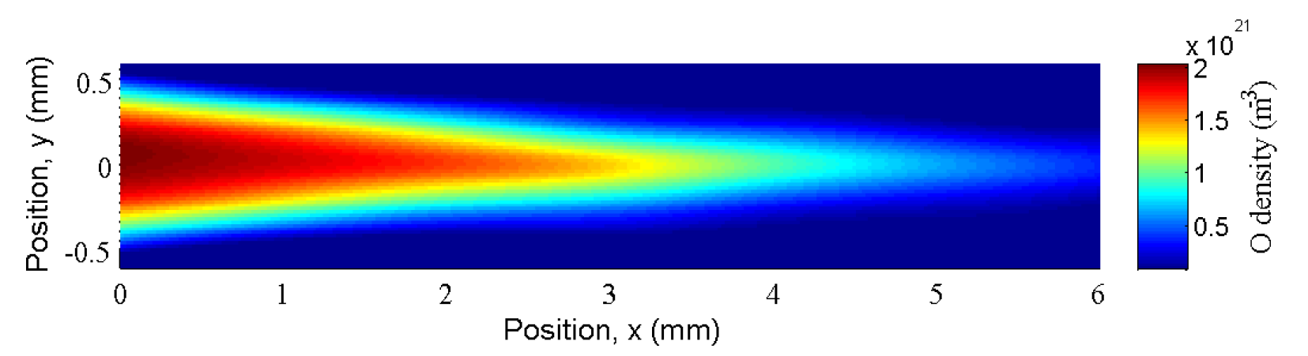
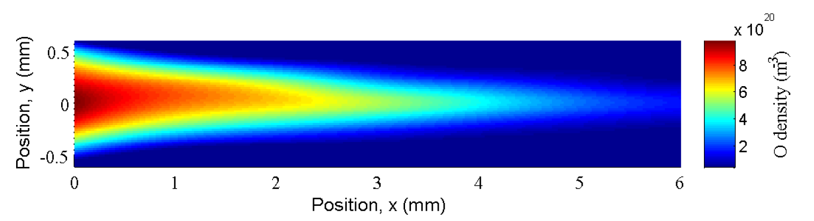
Plasma plume characterization:
Atomic densities
Oxygen
Synthetic air

Slide 12
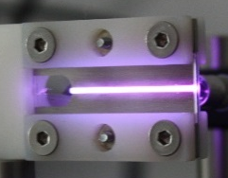
Picosecond-TALIF:
Experimental set-up
μAPPJ
on 3-axis translation stage
Example species
O 225.58 nm
N 206.65 nm
H 205.08 nm
Variable
attenuator
Picosecond laser system:
30 ps pulses @ 10 Hz
λ: 193-2300 nm
Narrow bandwidth
Photodiode
Laser energy
feedback
Interference filter
ICCD detector, sub-nanosecond resolution
Pre-trigger
Delay generator
12

Slide 13
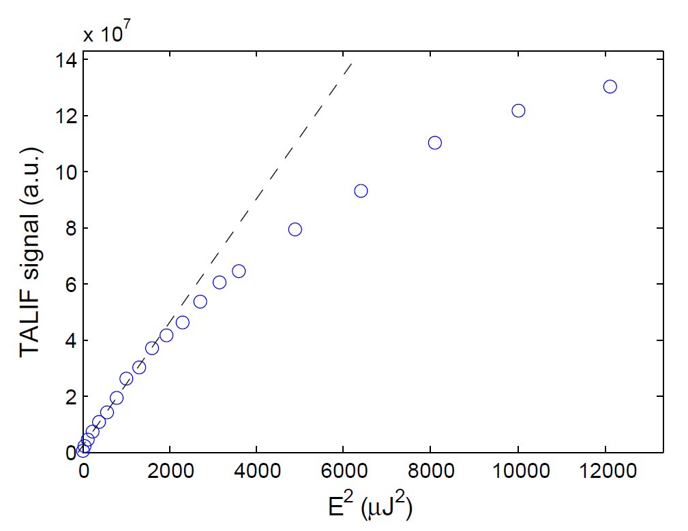
Picosecond-TALIF:
Oxygen TALIF scheme
Photo-ionisation
Ionisation threshold
1 x 225.62 nm
3p ³P_{1,2,0}
844.87 nm
3s ³S
TALIF signal
laser excitation 2 x 225.62 nm
E²_{Laser}
40 μJ
2p⁴ ³P_{2,1,0}
13
Notes:
Signal prop to sq of energy/intensity – 2 photon
Energy is per time

Slide 14

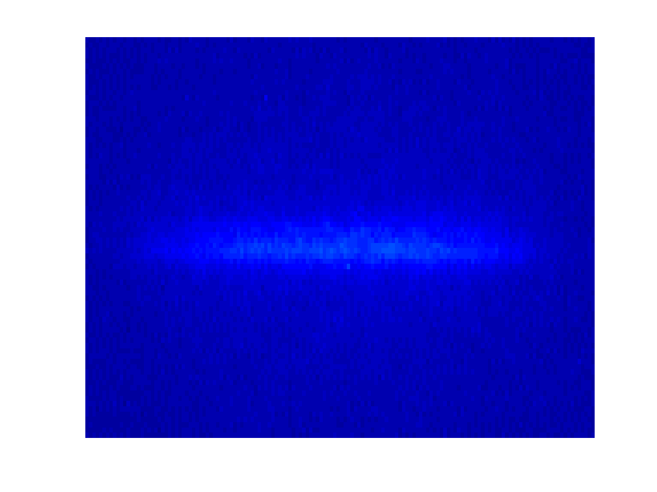
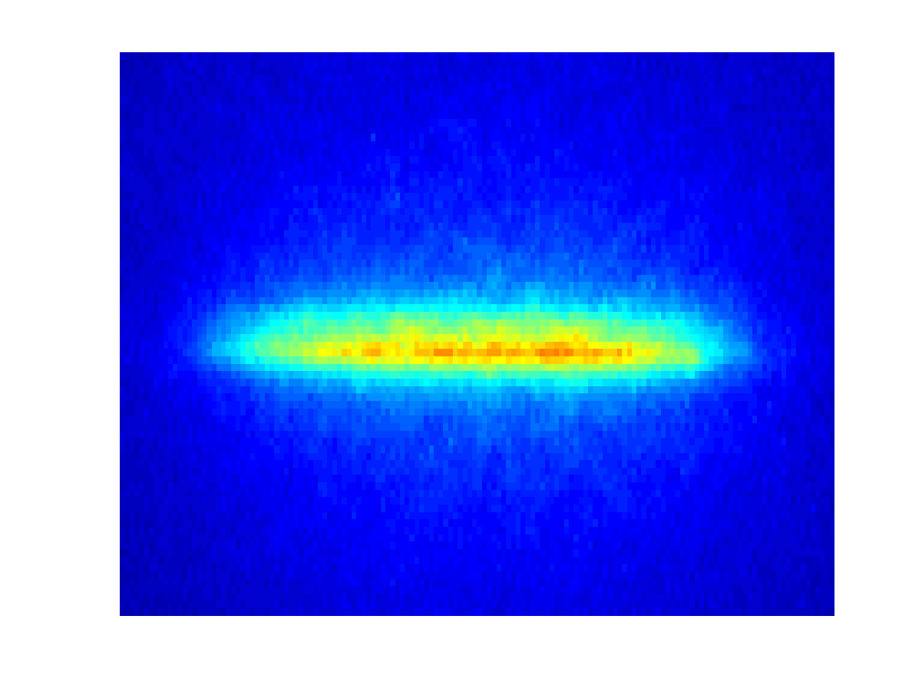
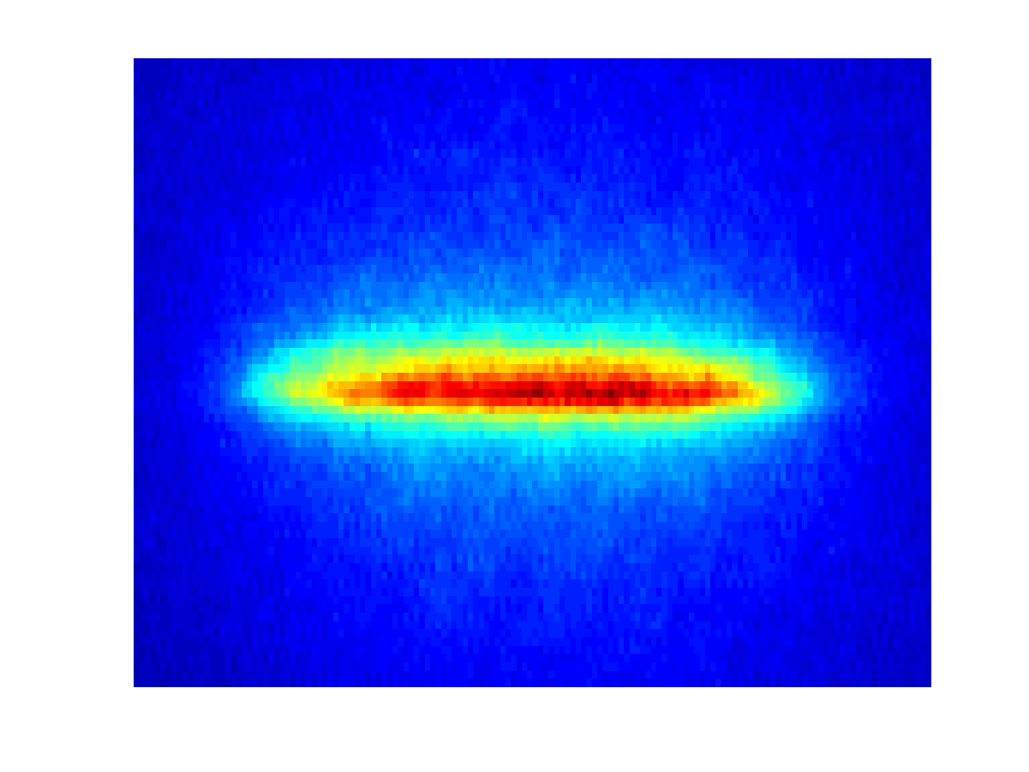
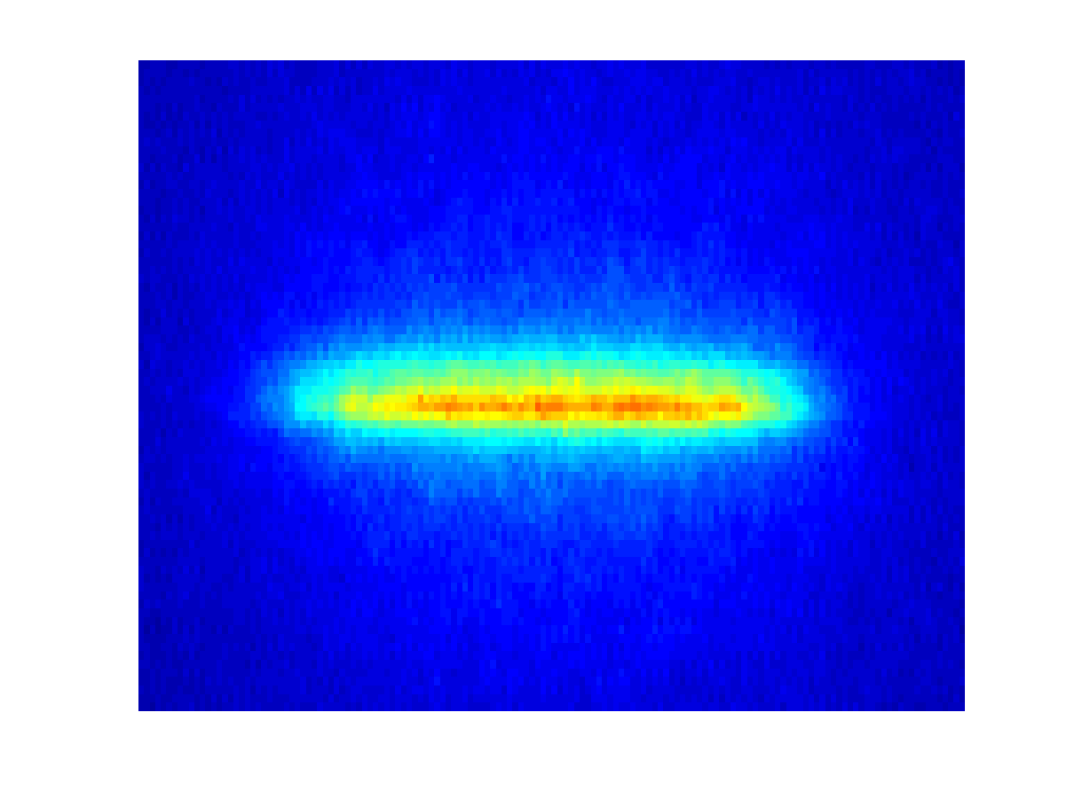
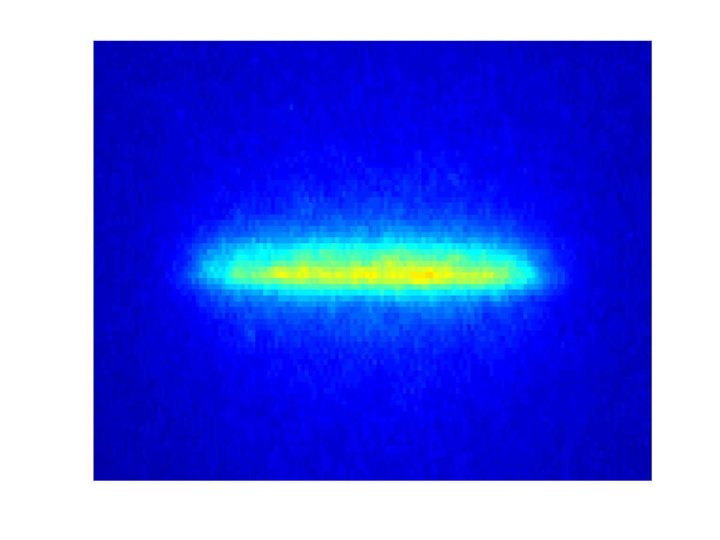
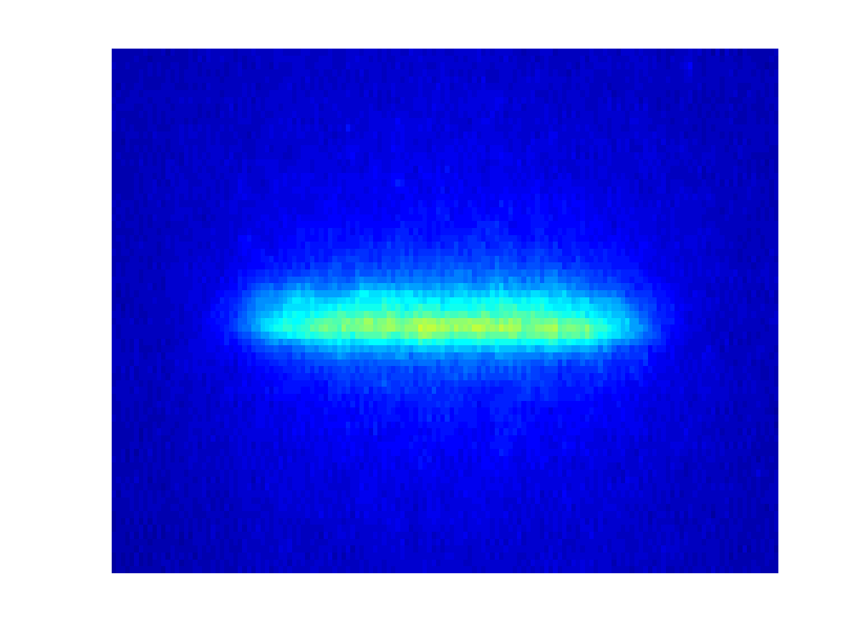
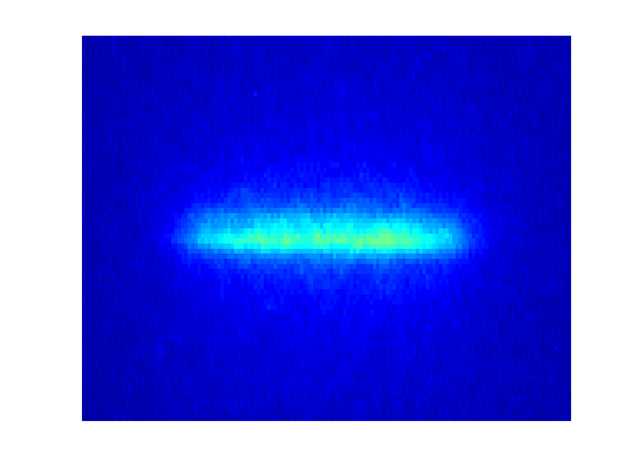
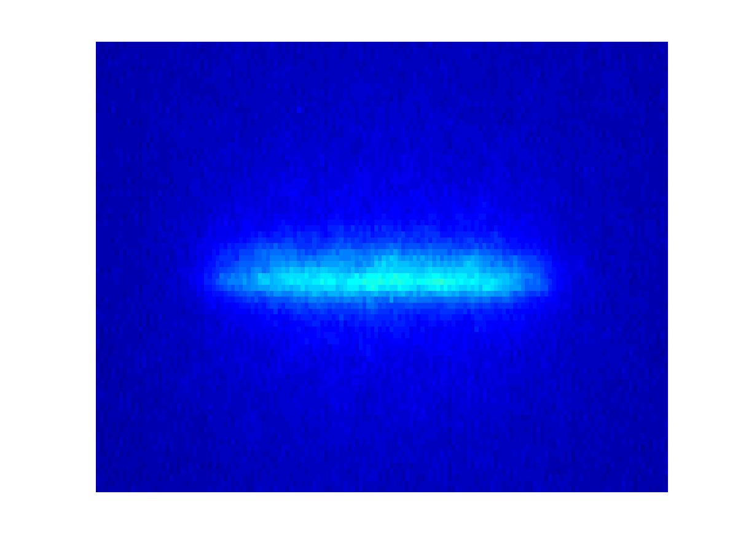
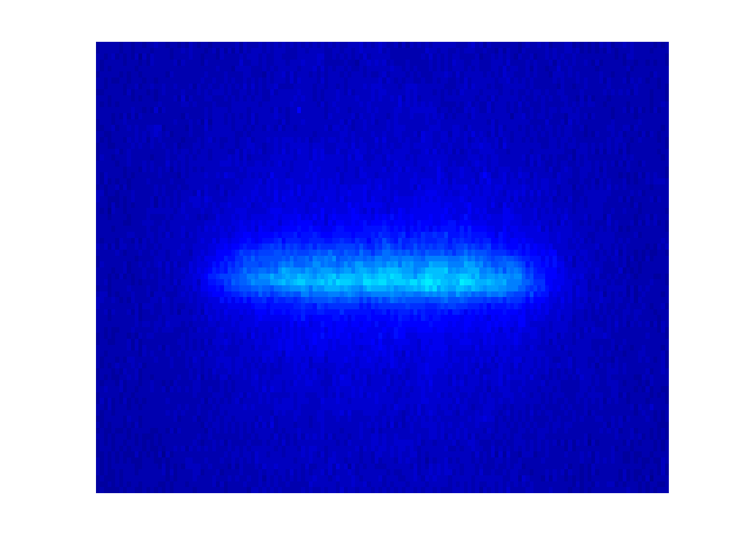
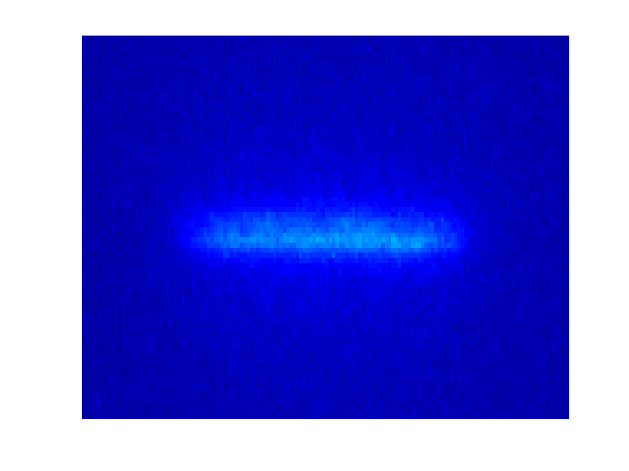
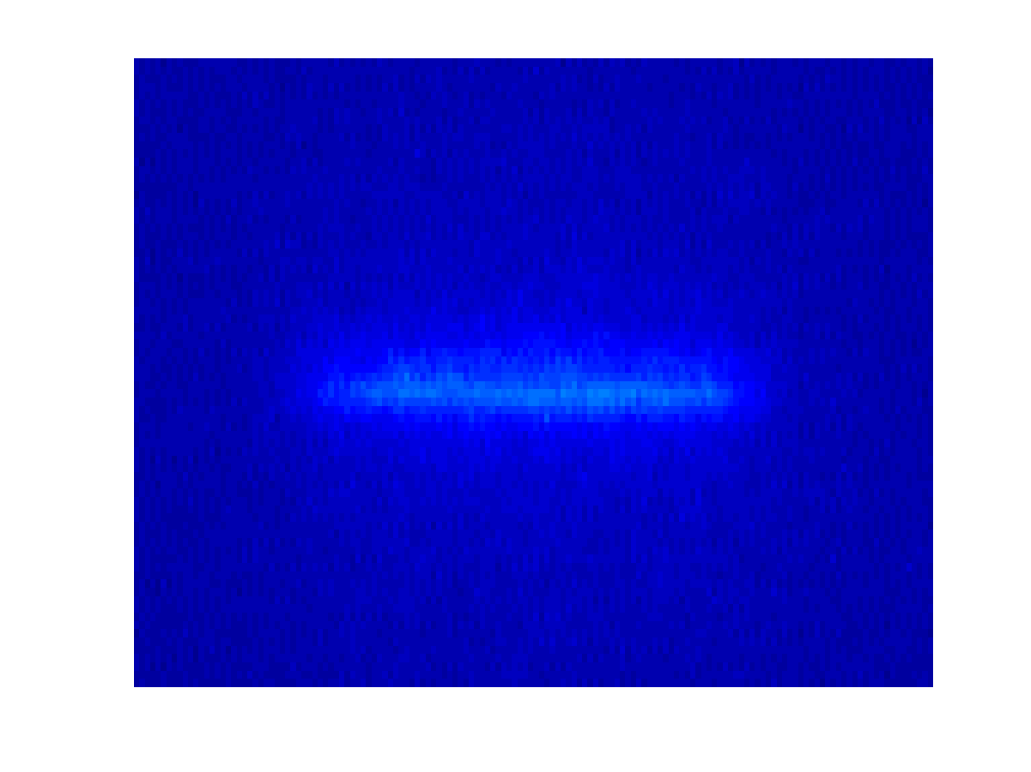
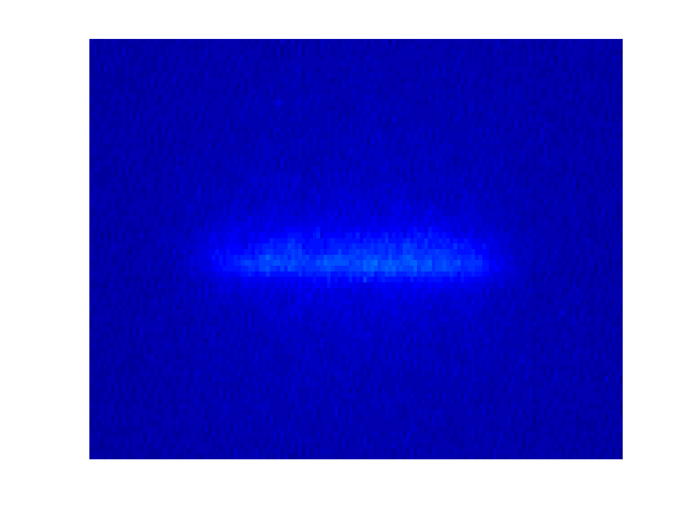
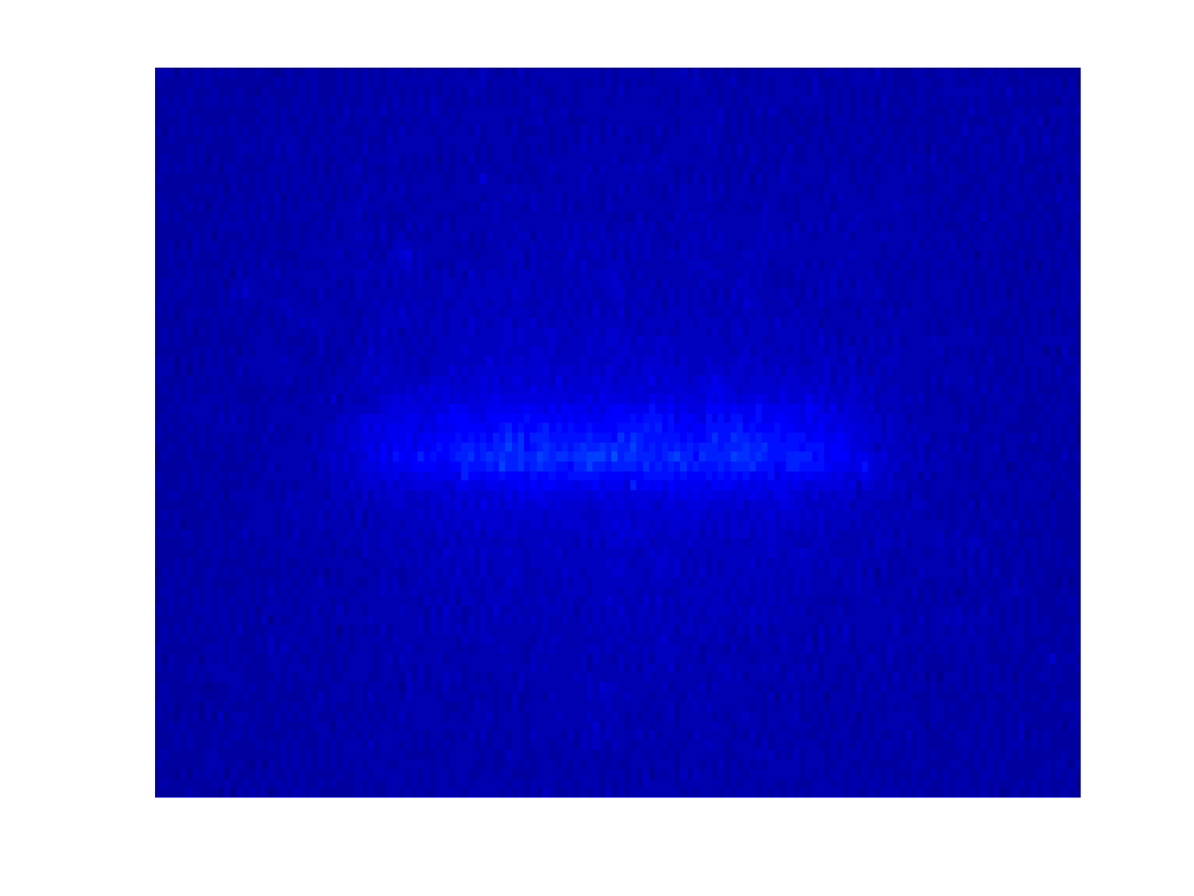
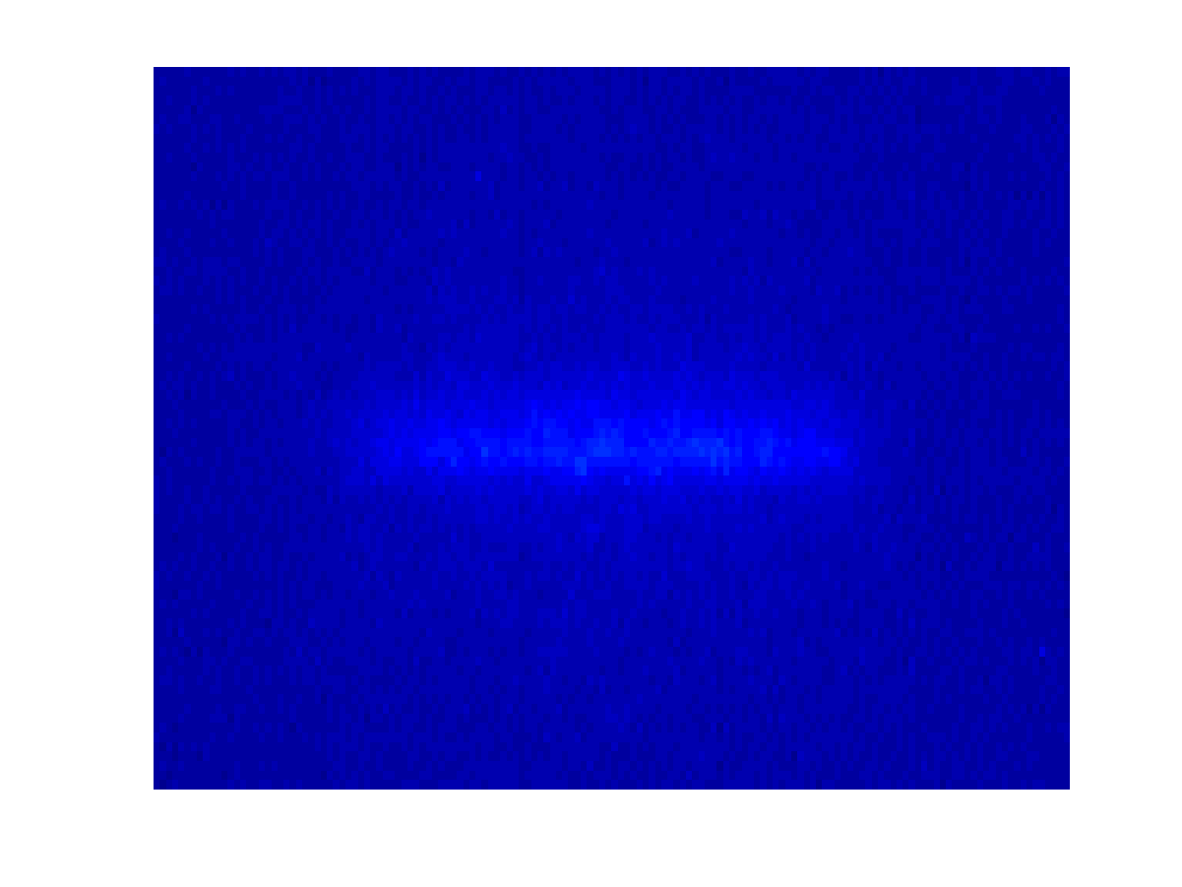
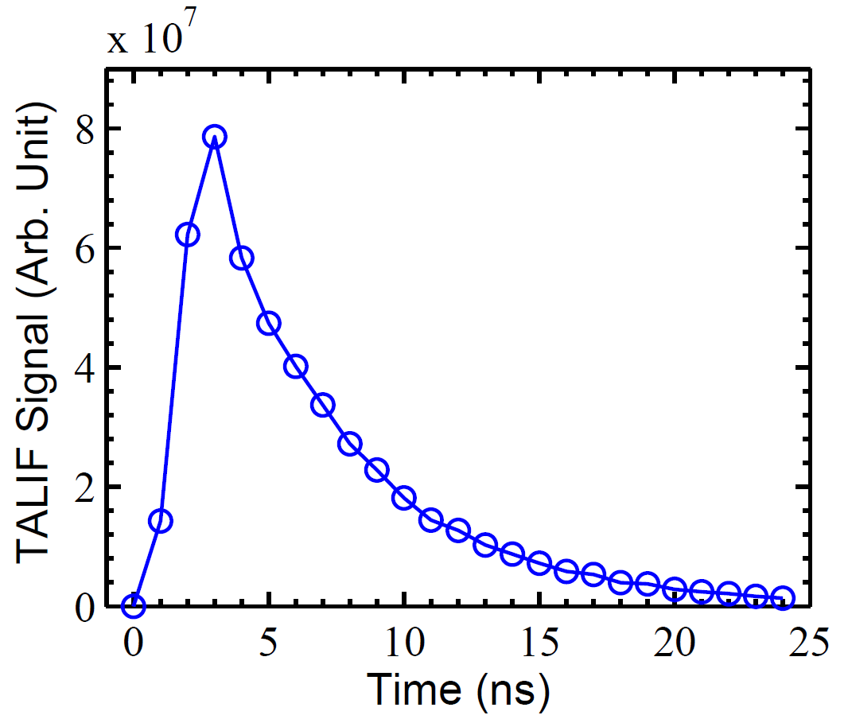
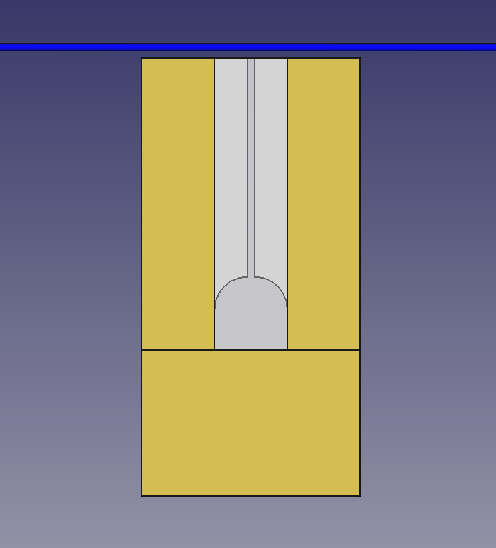
Picosecond TALIF: Signal acquisition
Camera gate width = 2 ns
Delay step = 1 ns
Laser shot
14

Slide 15
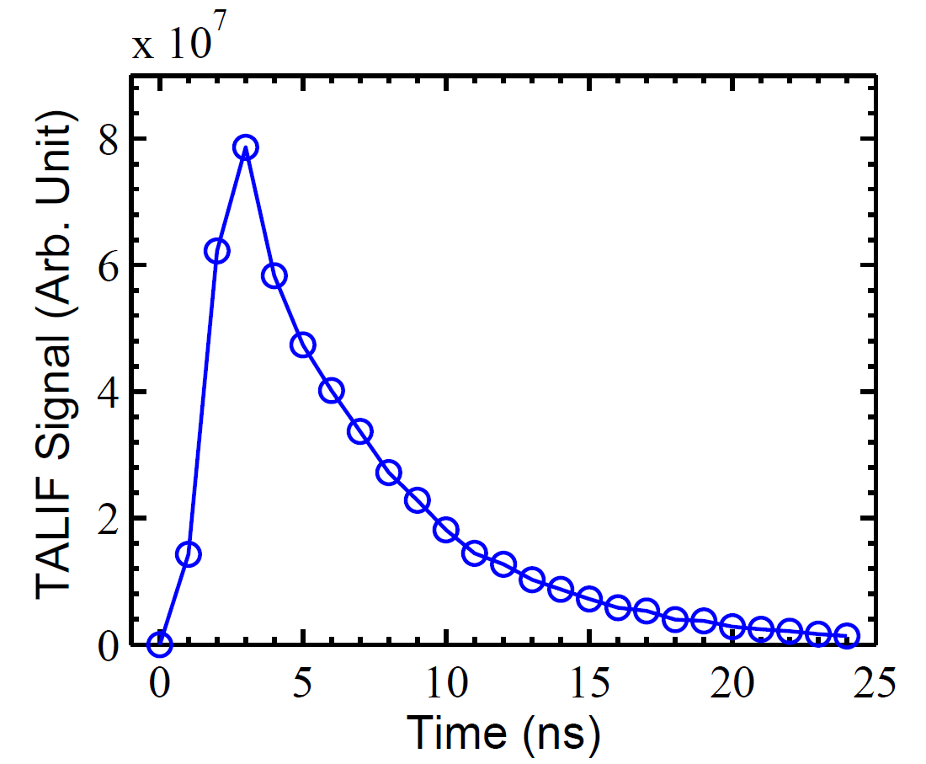
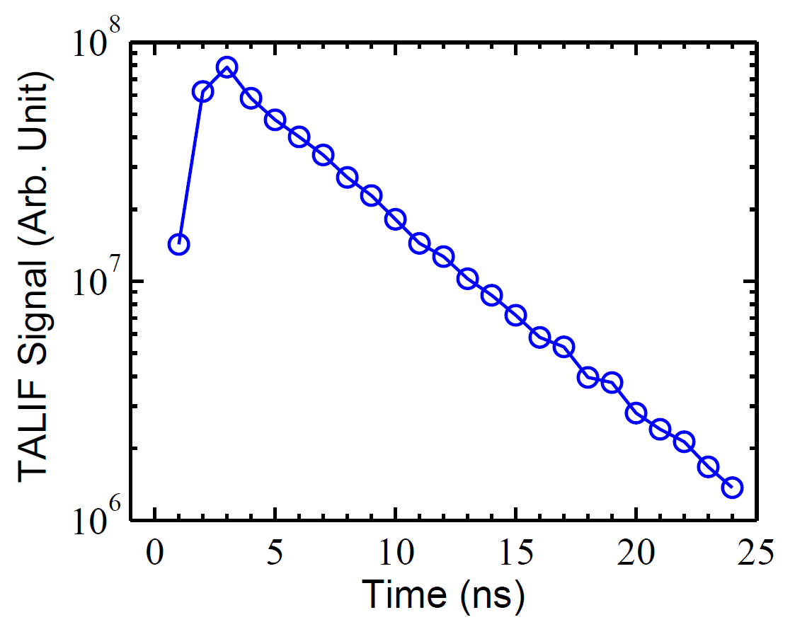
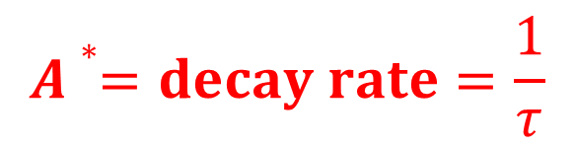
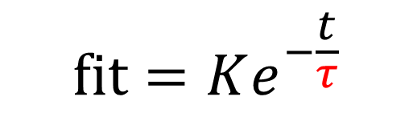
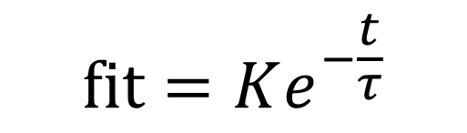
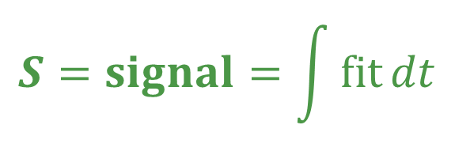
Picosecond TALIF: Extraction of parameters
$$fit=Ke^{−\frac{t}{τ}}$$
$$fit=Ke^{−\frac{t}{τ}}$$
$$A∗=decay rate=\frac{1}{τ}$$
$$S=signal=\int{fit}dt$$
relative density = S x A*
15

Slide 16
Picosecond-TALIF:
Calibration schemes
Oxygen
Xenon
3p ³P_{1,2,0}
6p'[3/2]₂
844.87 nm
834.91 nm
3s ³S
6s'[1/2]₁
2 x 225.65 nm
2 x 224.31 nm
2p⁴ ³P_{2,1,0}
5p⁶ ¹S₀
Excitation at the same wavelength
➔ important to keep the laser properties identical
16
K. Niemi et al., Plasma Sources Sci. Technol. 14 (2005) 375-386

Slide 17
Picosecond-TALIF:
Calibration schemes
Nitrogen
Hydrogen
Krypton
3p ⁴S_{3/2}
3d ²D_{3/2,5/2}
5p’[3/2]₂
742-746 nm
656.3 nm
826.3 nm
3s ⁴P_{1/2,3/2,5/2}
2p ²P_{1/2,3/2}
5s’[1/2]₁
2 x 206.65 nm
2 x 205.08 nm
2 x 204.13 nm
2p³ ⁴S_{3/2}
1s ²S_{1/2}
4p⁶ ¹S₀
Excitation at the same wavelength
➔ important to keep the laser properties identical
17

Slide 18
Picosecond-TALIF:
Calibration set-up
Variable
attenuator
Calibration cell
filled with Xe
Picosecond laser system:
30 ps pulses @ 10 Hz
λ: 224.28 nm
Photodiode
Laser energy
feedback
Interference filter
834 nm
ICCD detector, sub-nanosecond resolution
Pre-trigger
Delay generator
18

Slide 19
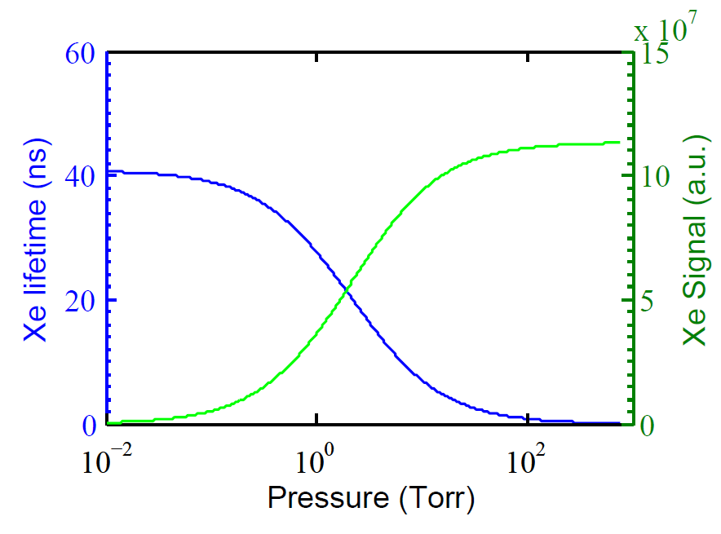
Picosecond TALIF: Pressure inside the cell
p_{Xe} = 10 Torr
Compromise between signal and lifetime
Use the same camera gate width for both O & Xe
19

Slide 20
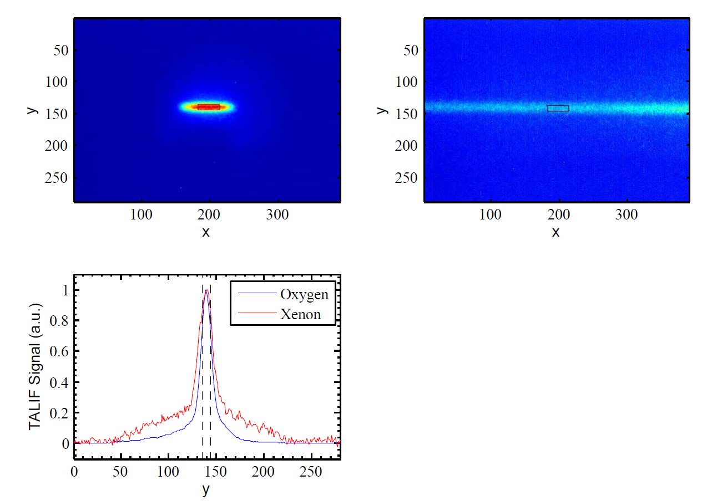
Picosecond TALIF: Calibration with xenon
0.5% oxygen
p_{Xe} = 10 Torr
T: transmission of the detection optics
η: detector’s quantum coefficient
σ: two-photon absorption cross section
hν: incident photon energy
A_{ik}: Einstein coefficient
τ: effective lifetime
S: fluorescence signal
From literature
Measured
20

Slide 21
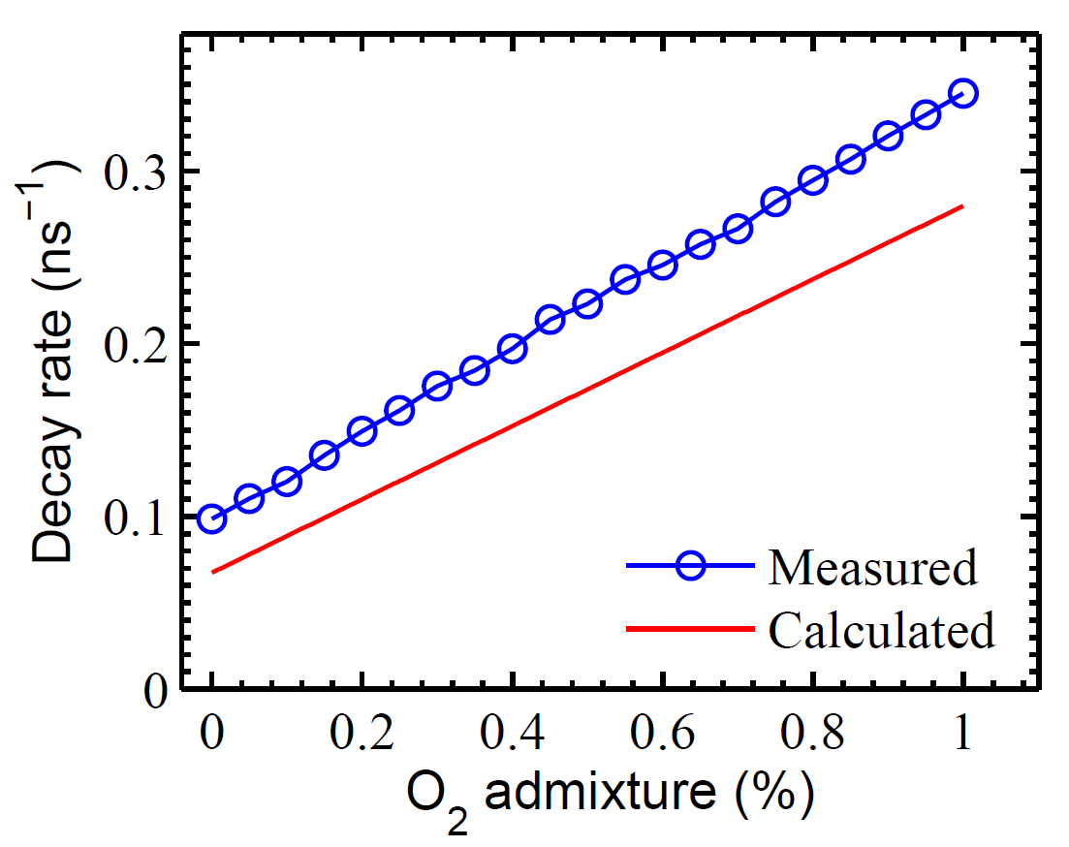
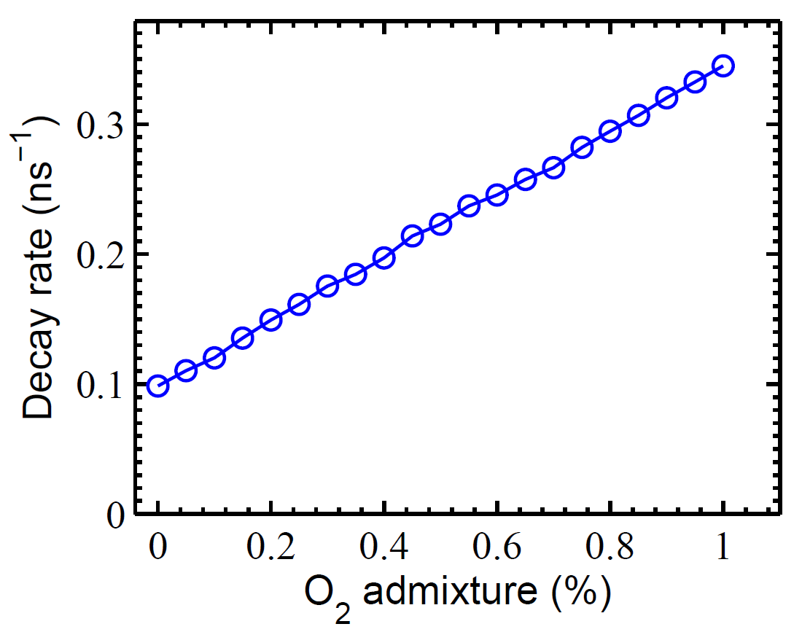
Measured vs calculated decay rate
Difference between measured & calculated
Too large to be due to uncertainty of He quenching coefficient
does not depend on admixture
➔ Might be induced by 3 body collisions with He
Uncertainty in the calculated decay rate
➔ Error introduced in the density calculation
➔ For reliable density measurement, decay rate should be measured

Slide 22
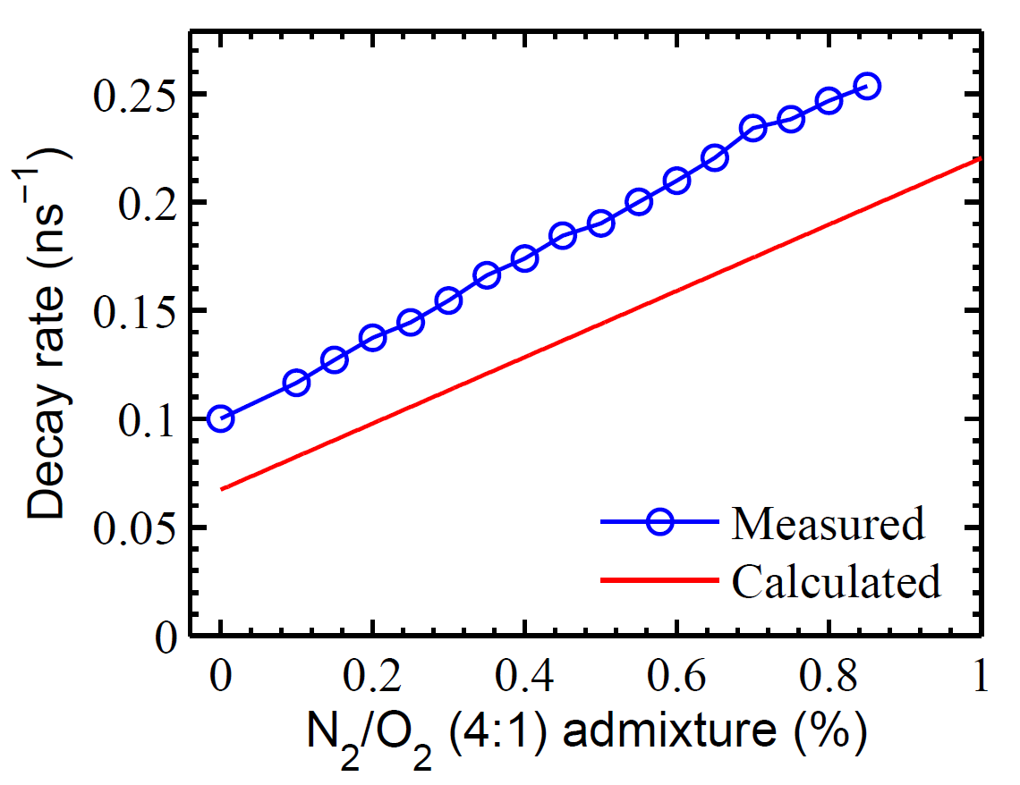
Measured vs calculated decay rate
Uncertainty in the calculated decay rate
➔ Error introduced in the density calculation
➔ For reliable density measurement, decay rate should be measured

Slide 23
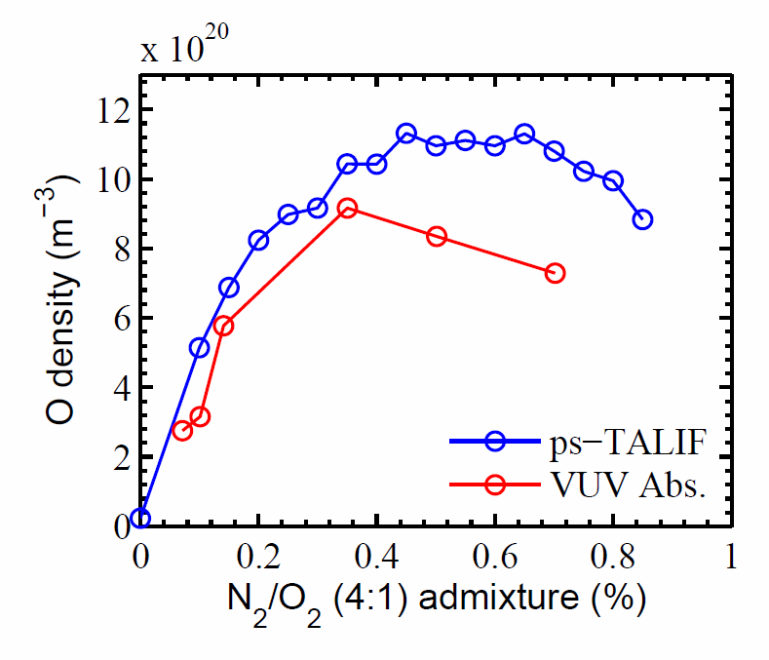
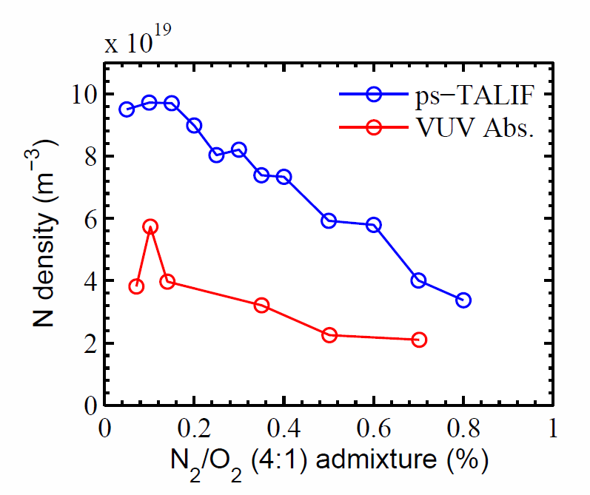
Comparison:
Synchrotron VUV absorption
Synthetic air admixture variation
Niemi et al. – 2013 – APL 103 034102
Quantitative and qualitative agreement
Synthetic air ➔ complex gas mixture
23

Slide 24
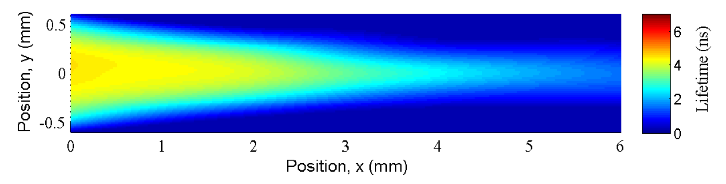
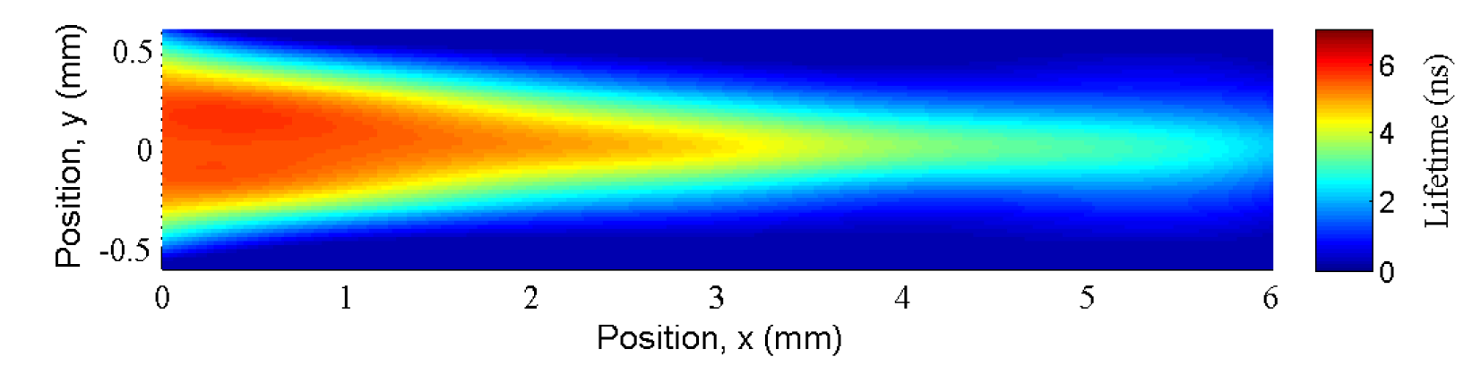
Plasma plume characterization:
Oxygen vs synthetic air
Oxygen
Synthetic air

Slide 25
Plasma plume characterization:
Oxygen vs synthetic air
Oxygen
Synthetic air

Slide 26
Thank you!

